Slide 1
Lowest Common Manager
2023/03/20

Slide 2
Space and Time algorithm
Time = O(n) (have to go through all the members in the tree)
Space = O(d) (d = depth of the tree)

Slide 3
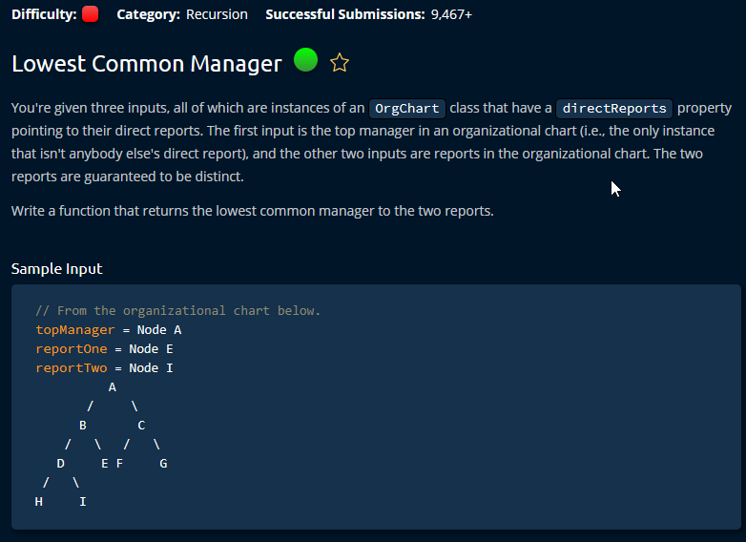

Slide 4
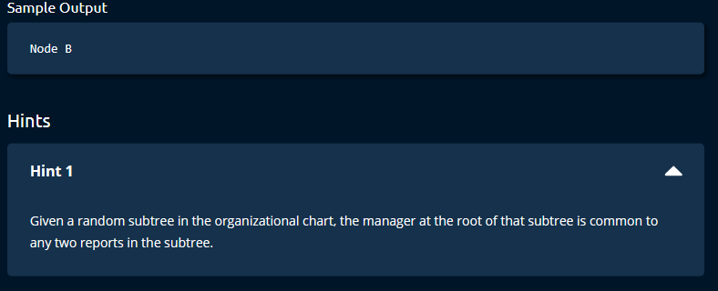

Slide 5
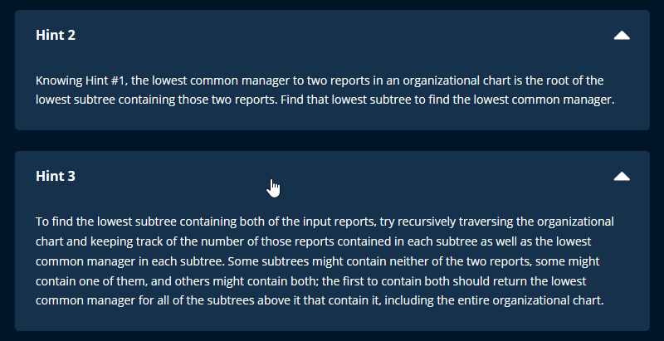

Slide 6
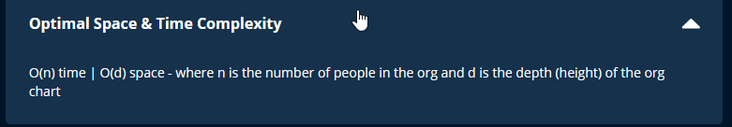

Slide 7
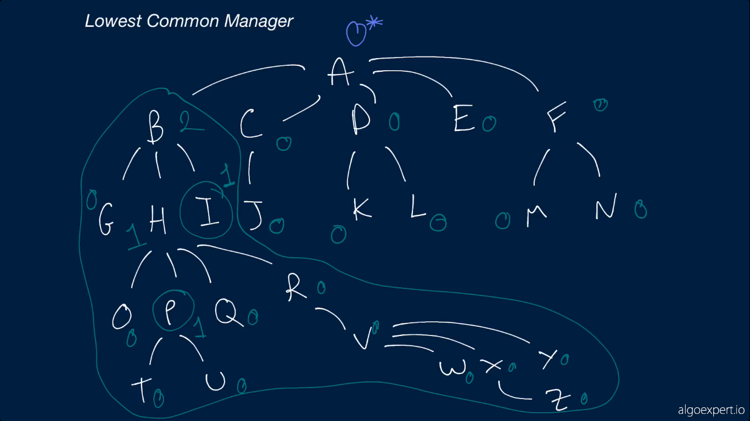

Slide 8
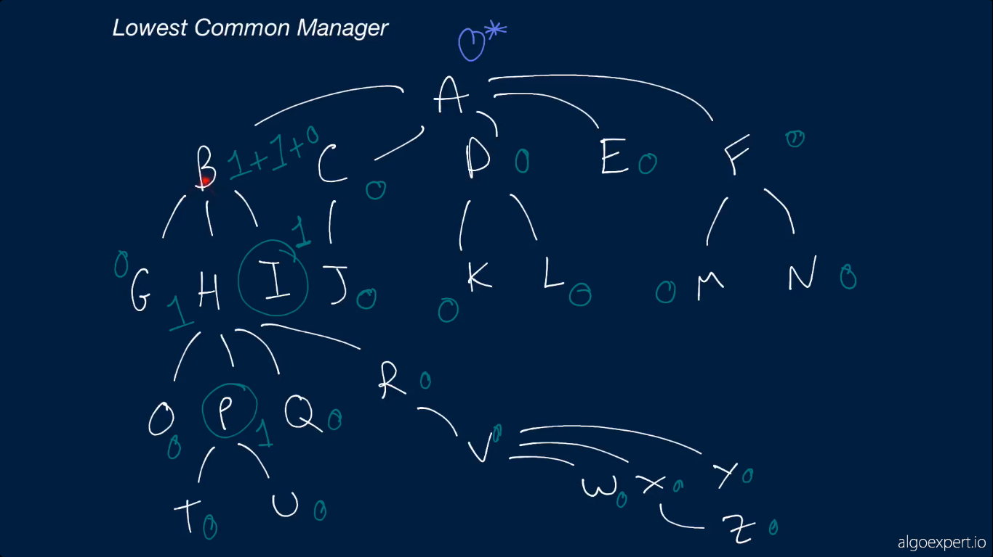

Slide 9
